Slide 1
METATITANS
Submitted By:
Aiswarya Kinattukara Kalam -245182
Christo Shaji -245052
Meera Javad -245217
Swetha S -245154

Slide 2
Contents
Feign Client
Rest Client
Web Client
Three types of communication
Eureka Server
Api gateway
Config server
Distributed tracing system

Slide 3
Feign Client
In modern software development, applications often need to communicate with other services through HTTP requests.
However, manually managing these requests can be complex and time-consuming.
Feign client offers a solution by providing a higher-level abstraction for making HTTP requests.
Challenges of Manual Request Management:
Complex request configurations: Configuring headers, query parameters, authentication, and request bodies can be error-prone and tedious.
Error handling: Handling different HTTP response codes and handling errors requires extra effort.
Service discovery: Locating and connecting to various services in a distributed environment can be challenging.

Slide 4
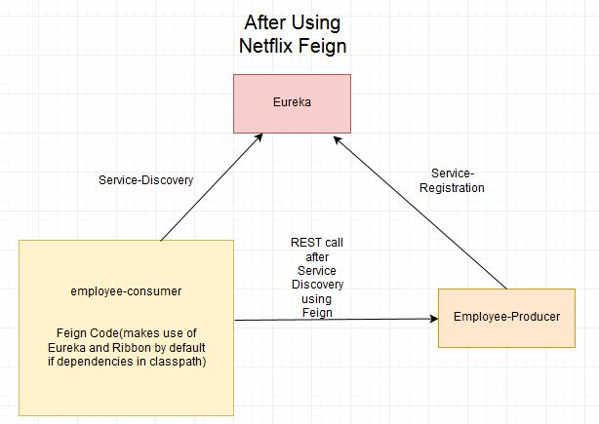
Feign Client
Feign is a declarative web service client developed by Netflix.
It simplifies the process of making HTTP requests by abstracting away the low-level details.
With Feign, developers can focus on defining the desired requests and parameters instead of dealing with boilerplate code.

Slide 5
Feign allows developers to define HTTP requests using annotations or interfaces.
Developers can annotate methods in an interface with HTTP request details such as URL, HTTP method, headers, and parameters.
Feign handles the creation of the actual HTTP requests based on these
Annotations.
Integration with Spring Cloud:
Feign integrates seamlessly with Spring Cloud, a framework for building distributed systems.
It leverages Spring Cloud's features such as service discovery, load balancing, and circuit breakers.
Developers can use Feign as a client to communicate with other services in a Spring Cloud ecosystem.

Slide 6
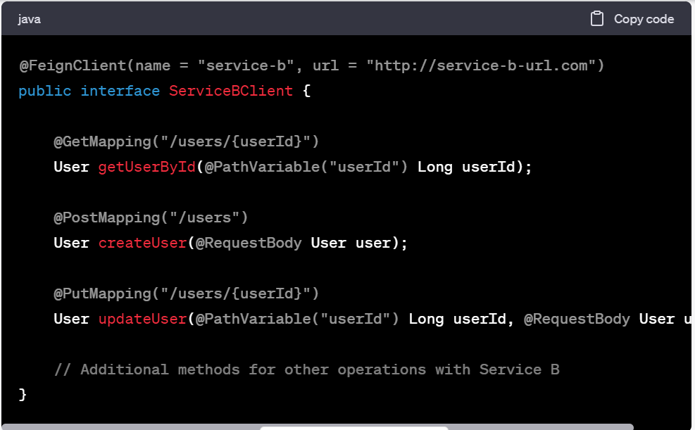
Example Usage
Example Scenario:
Let's consider a scenario where we have a microservice architecture, and Service A needs to communicate with Service B using HTTP requests.
Feign Client Usage:
To use Feign, you define an interface that represents the API of Service B.
Annotate the methods in the interface with Feign annotations to specify the details of the HTTP requests.

Slide 7
Benefits of Feign:
Simplified HTTP Request Configuration:
Feign abstracts away the complexities of setting up HTTP requests manually.
Developers can focus on the intent of the request rather than the low-level implementation details.
Improved Readability and Maintainability:
Feign's declarative approach leads to cleaner and more readable code.
It helps in maintaining a separation of concerns between application logic and HTTP request configurations.

Slide 8
Key Features
Load Balancing and Service Discovery:
Feign integrates with Spring Cloud's service discovery mechanism.
It supports load balancing among multiple instances of the target service.
Feign can automatically discover and distribute requests to available service instances.
Error Handling and Retry:
Feign provides built-in error handling mechanisms.
It can handle HTTP response codes and throw exceptions based on configurable error conditions.
Feign also supports automatic retry of failed requests with customizable retry policies.
Request and Response Interceptors:
Feign allows developers to add custom interceptors to modify requests and responses.
Interceptors can be used for tasks such as logging, authentication, adding headers, or modifying the request payload.

Slide 9
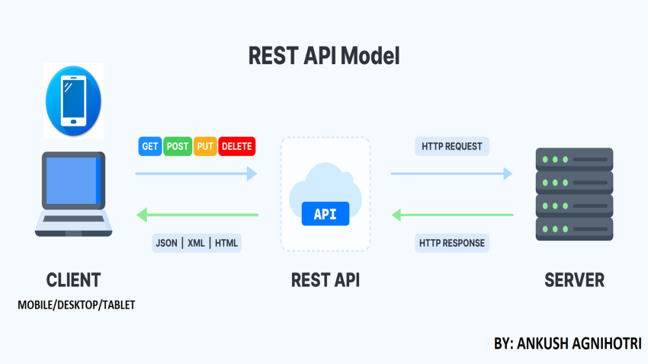
REST Client
In modern web development, RESTful APIs play a crucial role in enabling communication between client applications and server-side systems.
However, to interact with these APIs effectively, we need a mechanism to send HTTP requests and receive responses.
This is where a REST client comes into play.
A REST client is an application or tool that facilitates the consumption of RESTful APIs.
It allows developers to send HTTP requests to a server and receive responses in a structured manner.
A REST client can be a web browser, a command-line tool, or a library/framework in a programming language.

Slide 10
Types of REST Clients:
Web Browsers:
Web browsers, such as Chrome, Firefox, and Safari, act as REST clients when accessing web-based applications and consuming their APIs.
They allow users to send HTTP requests (e.g., GET, POST) to the server and receive the corresponding responses.
Command-Line Tools:
Command-line tools like cURL and HTTPie provide a command-line interface to interact with RESTful APIs.
Developers can use these tools to construct and send HTTP requests from the command line and receive the responses.
Programming Language Libraries and Frameworks:
Many programming languages offer libraries and frameworks that act as REST clients, simplifying the consumption of RESTful APIs.
These libraries provide functionalities for constructing HTTP requests, handling responses, and parsing data.

Slide 11
Key Features of a REST Client
HTTP Methods:
REST clients support the standard HTTP methods, including GET, POST, PUT, DELETE, PATCH, etc.
Developers can choose the appropriate method based on the desired operation to be performed on the RESTful API.
Request Building:
REST clients provide a way to construct HTTP requests with ease.
Developers can specify the request URL, headers, query parameters, request body, and other relevant details using the REST client's interface or API.
Response Parsing:
REST clients handle the parsing of HTTP responses received from the server.
They provide methods or mechanisms to extract relevant data from the response, such as response status codes, headers, and response bodies.

Slide 12
Features
Authentication and Authorization:
REST clients often support various authentication mechanisms for secure communication with the RESTful API.
They provide ways to include authentication tokens, API keys, or OAuth credentials in the requests to authenticate the client.
Error Handling:
REST clients handle different response codes returned by the server.
They provide mechanisms to handle and interpret error responses, such as client-side errors (4xx) and server-side errors (5xx).
REST clients may offer customizable error handling strategies, including retry mechanisms and error response parsing.
Additional Features:
Caching: Some REST clients support caching mechanisms to improve performance and reduce network overhead.
Interceptors: REST clients may offer interceptors to modify requests or responses before they are sent or received, allowing for customization and additional functionalities.

Slide 13
Web Client
Web Client is a non-blocking, reactive client to perform HTTP requests, exposing a fluent, reactive API over underlying HTTP client libraries such as Reactor Netty. To use Web Client in our Spring boot project, we have to add Spring Web Flux dependency to the classpath.
The web client is responsible for presenting the user interface, handling user inputs, and making requests to the appropriate microservices to perform actions or retrieve data. It provides a means for users to interact with the application and access the services provided by the microservices.
The web client may interact with multiple microservices to fulfill a single user request or to display various components of the user interface. For example, if a user wants to view a product listing page, the web client may need to request product information from one microservice, pricing information from another microservice, and review information from yet another microservice. It integrates the responses from these microservices to present a unified view to the user

Slide 14
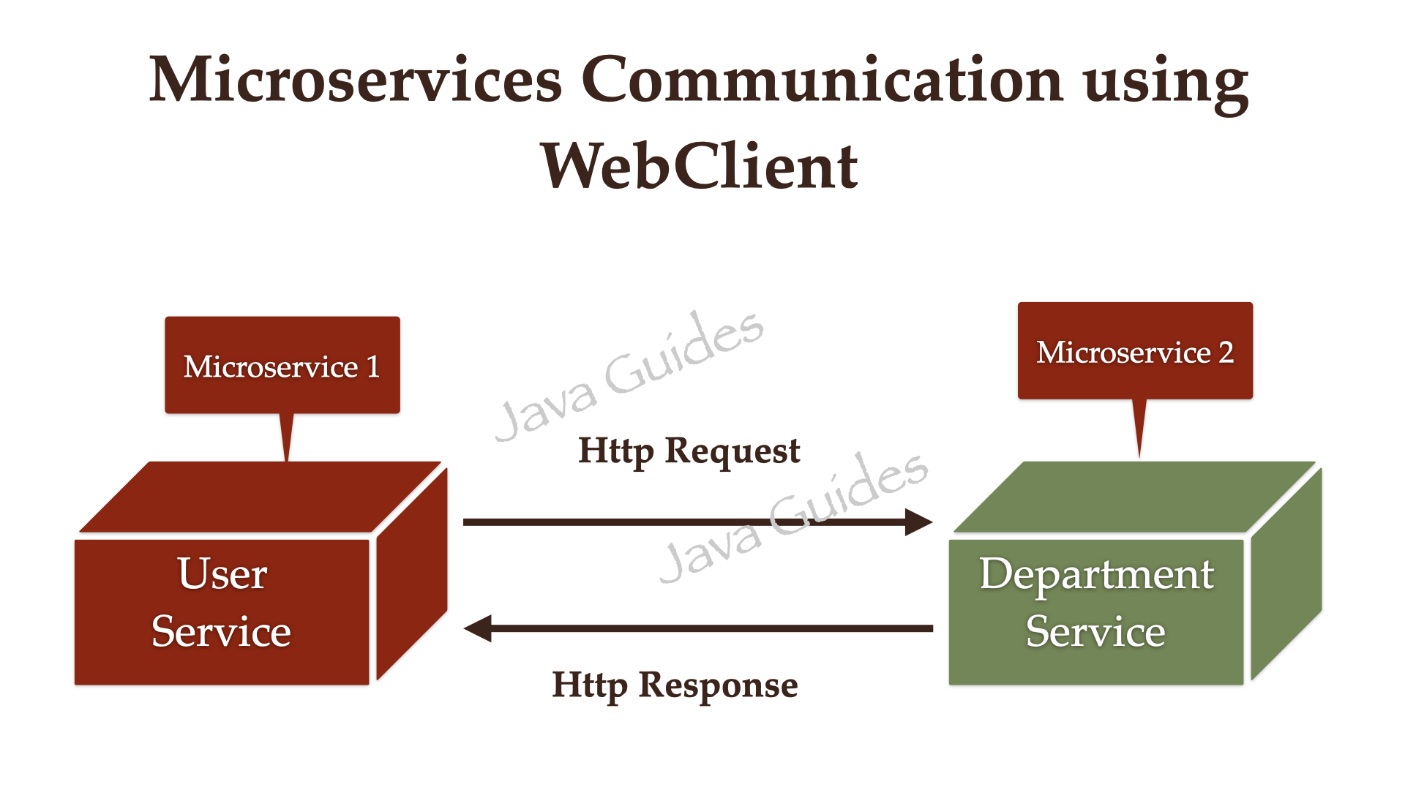

Slide 15
Features of a web client in a microservices architecture
1.User Interface: The web client provides a user-friendly and intuitive interface for users to interact with the application. It includes components such as forms, buttons, menus, and visual elements that enable users to perform actions and navigate through the application.
2.Authentication and Authorization: The web client handles user authentication, allowing users to log in and securely access their resources. It manages user sessions, tokens, and credentials, ensuring that only authorized users can access specific microservices and perform certain actions.
3.API Consumption: The web client interacts with the APIs exposed by the microservices to send requests and receive responses. It makes HTTP requests to the appropriate endpoints, passing the required parameters and data. The web client handles response parsing and error handling, displaying appropriate feedback to the user.

Slide 16
Spring Boot Microservices Communication using WebClient
Step 1: Add Spring WebFlux Dependency
<dependency>
<groupId>org.springframework.boot</groupId>
<artifactId>spring-boot-starter-webflux</artifactId>
</dependency>
Step 2: Configure WebClient as Spring Bean
@Bean
public WebClient webClient(){
return WebClient.builder().build();
}

Slide 17
Step 3: Inject and Use WebClient to Call the REST API
DepartmentDto departmentDto = webClient.get()
.uri("http://localhost:8080/api/departments/" + user.getDepartmentId())
.retrieve()
.bodyToMono(DepartmentDto.class)
.block();

Slide 18
Types of communication in microservices
There are three types of communication in microservices
1.Synchronous Communication: In synchronous communication, a client sends a request to a microservice and waits for a response before proceeding. This communication pattern typically involves a direct request-response mechanism, where the client waits for the microservice to process the request and return the corresponding response. HTTP/HTTPS-based REST APIs are commonly used for synchronous communication in microservices architecture.
Example: A client sends an HTTP request to a user microservice to retrieve user information. The client waits for the microservice to process the request and returns the requested user details as an HTTP response.

Slide 19
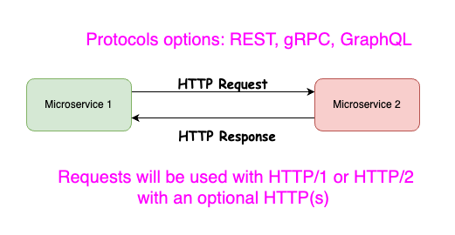

Slide 20
2.Asynchronous Communication: Asynchronous communication involves decoupled interaction between microservices. Instead of waiting for an immediate response, the client sends a message/event to a message broker or a message queue, and the microservice receives and processes the message asynchronously. The client can continue with its execution without waiting for the response. Asynchronous communication is often used when the response time is not critical or when the microservice's processing might take a significant amount of time.
Example: A client publishes an event to a message broker indicating that a new order has been placed. The order service, subscribed to this event, processes it at its own pace without blocking the client. The order service may update the database, send notifications, and perform other tasks related to order processing.

Slide 21
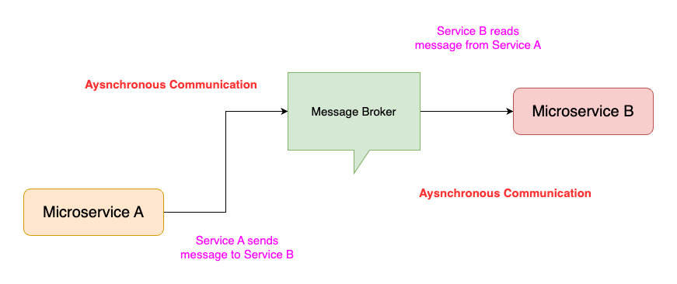

Slide 22
3.Event-Driven Communication: Event-driven communication is a variant of asynchronous communication where microservices communicate with each other by producing and consuming events. Microservices publish events to a central event bus or message broker, and other microservices can subscribe to the events they are interested in. This pattern promotes loose coupling between microservices and enables them to react to changes or trigger actions based on events.
Example: A user microservice publishes a user created event to the event bus when a new user account is created. Other microservices, such as a notification service or an email service, can subscribe to this event and take action accordingly, such as sending a welcome email to the new user or triggering other notifications.

Slide 23
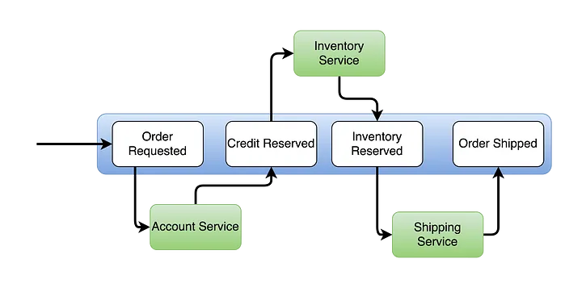

Slide 24
HTTP and REST Protocols
Two of the most common protocols that power many online apps are HTTP and REST. Both of these protocols use asynchronous communications because a request is sent to the server and awaits a response before doing anything else.
When a response is given, the client application will then take an “if-this” approach.
For example, if the response is an error code, the application will show an error or try the request again for an adequate response, depending on the internal logic.
AMQP a WCG/TCP
Internal communications may be made by TCP or WCG, which are common when using a Docker host. Microservice clusters will often use internal communications between microservices using what is considered a “non-standard” binary approach.

Slide 25
Client and services can communicate through many different types of communication, each one targeting a different scenario and goals.
Initially, those types of communications can be classified in two axes.
The first axis defines if the protocol is synchronous or asynchronous:
Synchronous protocol: HTTP is a synchronous protocol. The client sends a request and waits for a response from the service. That's independent of the client code execution that could be synchronous (thread is blocked) or asynchronous (thread isn't blocked, and the response will reach a callback eventually). The important point here is that the protocol (HTTP/HTTPS) is synchronous and the client code can only continue its task when it receives the HTTP server response.
Asynchronous protocol: Other protocols like AMQP (a protocol supported by many operating systems and cloud environments) use asynchronous messages. The client code or message sender usually doesn't wait for a response. It just sends the message as when sending a message to a RabbitMQ queue or any other message broker.

Slide 26
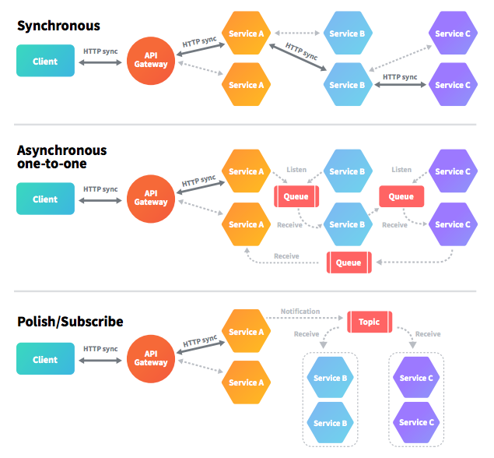

Slide 27
The second axis defines if the communication has a single receiver or multiple receivers:
Single receiver: Each request must be processed by exactly one receiver or service. An example of this communication is the Command pattern.
Multiple receivers: Each request can be processed by zero to multiple receivers. This type of communication must be asynchronous. An example is the publish/subscribe mechanism used in patterns like Event-driven architecture. This is based on an event-bus interface or message broker when propagating data updates between multiple microservices through events; it's usually implemented through a service bus or similar artifact like Azure Service Bus by using topics and subscriptions.

Slide 28
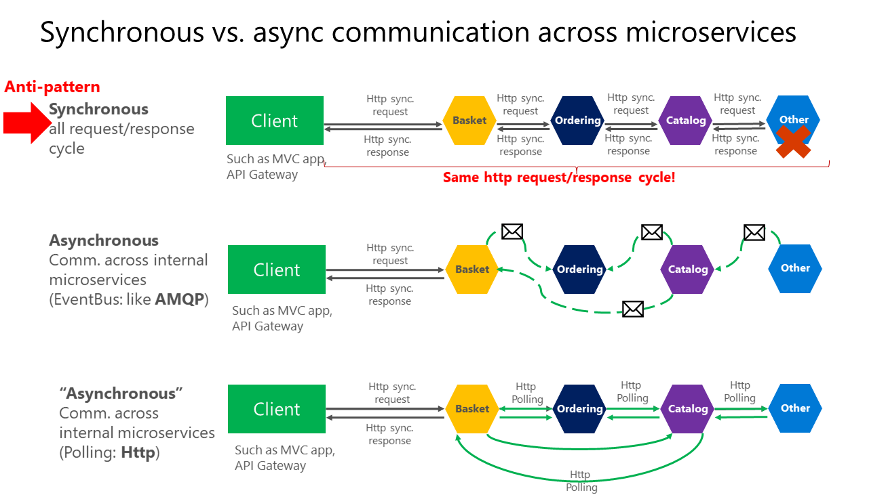

Slide 29
Eureka server
Eureka Server is an application that holds the information about all client-service applications. Every Micro service will register into the Eureka server and Eureka server knows all the client applications running on each port and IP address. Eureka Server is also known as Discovery Server.
Eureka Server is a core component of Netflix OSS (Open Source Software) used for service registration and discovery in a microservices architecture.
It acts as a service registry and discovery server, allowing services to register themselves and clients to locate and interact with these services dynamically.
Eureka Server maintains a centralized registry of available services, where services register themselves by providing metadata such as service name, IP address, port, and health check information.

Slide 30
Key Features and Benefits of Eureka Server
Service Registration and Discovery: Eureka Server provides a centralized registry where services can register themselves, providing metadata such as service name, IP address, port, and health check information.
Clients can query the Eureka Server to discover and locate the services they need to communicate with.
Self-Healing Capability: Eureka Server continuously monitors the registered services and automatically removes instances that fail to send regular heartbeat signals.
This self-healing capability ensures that only healthy and available services are listed in the registry.
Load Balancing: Eureka Server includes built-in load balancing functionality.
It provides clients with multiple instances of a service, distributing incoming requests evenly across those instances.
This load balancing mechanism optimizes resource utilization and improves system performance.
Scalability and Fault Tolerance: Eureka Server is designed to handle the dynamic addition or removal of service instances without disrupting the overall system.
It allows for the replication of Eureka Server instances, ensuring redundancy and high availability of the service registry.

Slide 31
Key Features and Benefits of Eureka Server
Simplified Service Management: Eureka Server provides a centralized and transparent view of registered services, simplifying service management tasks.
It offers a comprehensive dashboard or API to monitor and track the status, health, and availability of service instances.
Interoperability with Frameworks and Libraries: Eureka Server integrates well with popular frameworks and libraries, such as Spring Boot.
It provides libraries and APIs that simplify the integration process, making it easier to incorporate Eureka Server into applications.

Slide 32
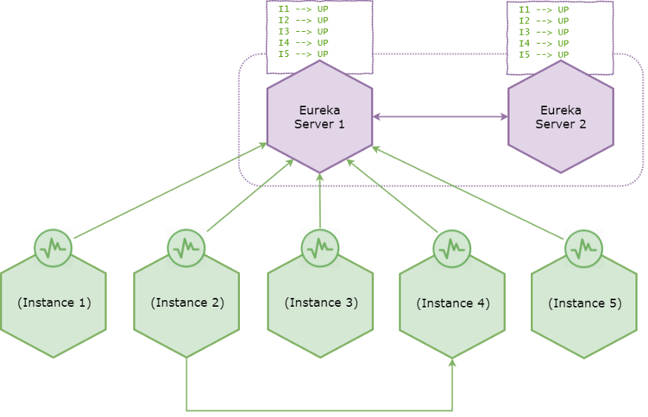
Architecture
Netflix Eureka architecture consists of two components, the Server and the Client.
The Server is a standalone application and is responsible for:
managing a registry of Service Instances
provide means to register, de-register and query Instances with the registry
registry propagation to other Eureka Instances (Servers or Clients).
The Client is part of the Service Instance ecosystem and has responsibilities like:
register and unregister a Service Instance with Eureka Server
keep alive the connection with Eureka Server
retrieve and cache discovery information from the Eureka Server.

Slide 33
Implementing eureka server
add spring-cloud-starter-netflix-eureka-server to the dependencies in pom.xml
<dependency>
<groupId>org.springframework.cloud</groupId>
<artifactId>spring-cloud-starter-netflix-eureka-server</artifactId>
</dependency>
enable the Eureka Server in a @SpringBootApplication by annotating it with @EnableEurekaServer
@SpringBootApplication
@EnableEurekaServer
public class EurekaServerApplication {
public static void main(String[] args) {
SpringApplication.run(EurekaServerApplication.class, args);
}
}

Slide 34
Implementing eureka server
Yml configuration
eureka:
server:
enable-self-preservation: false
instance:
hostname: localhost
client:
fetch-registry: false
register-with-eureka: false
server:
port: 5001

Slide 35
Api gateway
An API Gateway is a server that acts as a single entry point for client applications to access multiple APIs or microservices.
API Gateway provides a centralized and unified interface, handling request routing, authentication, rate limiting, request/response transformation, and more.
API gateway accepts API requests from a client, processes them based on defined policies, directs them to the appropriate services, and combines the responses for a simplified user experience. Typically, it handles a request by invoking multiple microservices and aggregating the results. It can also translate between protocols in legacy deployments.

Slide 36
Benefits of Api gateway
Simplified Client Communication: API Gateway provides a single endpoint for clients, eliminating the need to directly communicate with multiple services.
Increased Security: API Gateway can enforce authentication and authorization policies, protecting APIs and services from unauthorized access.
Improved Performance: By caching responses, reducing network round trips, and implementing rate limiting, API Gateway enhances overall system performance.
Scalability and Flexibility: API Gateway allows for easy scaling and adaptation of the underlying microservices architecture without impacting clients.

Slide 37
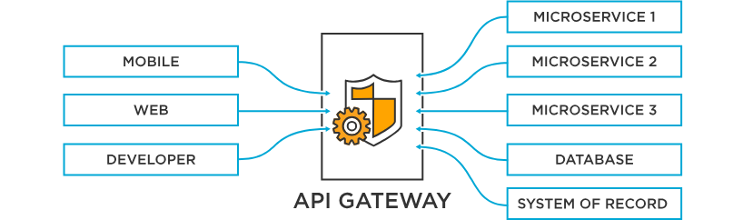
Api gateway capabilities
API gateways commonly implement capabilities that include:
Security policy – Authentication, authorization, access control, and encryption
Routing policy – Routing, rate limiting, request/response manipulation, circuit breaker, blue-green and canary deployments, A/B testing, load balancing, health checks, and custom error handling
Observability policy – Real-time and historical metrics, logging, and tracing
For additional app- and API-level security, API gateways can be augmented with web application firewall (WAF) and denial of service (DoS) protection.

Slide 38
Api gateway and microservices
For microservices‑based applications, an API gateway acts as a single point of entry into the system. It sits in front of the microservices and simplifies both the client implementations and the microservices app by decoupling the complexity of an app from its clients.
In a microservices architecture, the API gateway is responsible for request routing, composition, and policy enforcement. It handles some requests by simply routing them to the appropriate backend service, and handles others by invoking multiple backend services and aggregating the results.
An API gateway might provide other capabilities for microservices such as authentication, authorization, monitoring, load balancing, and response handling, offloading implementation of non-functional requirements to the infrastructure layer and helping developers to focus on core business logic, speeding up app releases.

Slide 39
Request routing and aggregation
Request Parsing: When a client sends a request to the API Gateway, the Gateway parses the request to extract information such as the request path, HTTP method, headers, and any query parameters.
Request Matching: The API Gateway compares the parsed request information against the configured routing rules or configuration. These rules define how incoming requests should be routed to the corresponding microservices.
Route Mapping: Based on the request matching process, the API Gateway identifies the specific route or endpoint within the microservices architecture that corresponds to the client's request.
Load Balancing: If multiple instances of the same microservice exist, the API Gateway may employ a load balancing strategy to evenly distribute the incoming requests across those instances. This ensures optimal resource utilization and improves overall system performance.
Forwarding the Request: Once the appropriate microservice or destination has been determined, the API Gateway forwards the client's request to that specific microservice. This involves rewriting the request as necessary, including any modifications to headers, parameters, or payload.

Slide 40
Request routing and aggregation
Handling the Response: After the microservice processes the request, it generates a response. The API Gateway receives this response and can optionally modify or transform it before sending it back to the client. This allows the Gateway to provide consistent and standardized responses to the clients, regardless of the underlying microservice implementation.
Error Handling: In case of errors or exceptions during the request processing, the API Gateway can intercept and handle them. It can return appropriate error responses to the client or perform additional actions like circuit breaking or fallback mechanisms

Slide 41
Config Server
A "config server" typically refers to a centralized system or service that stores and manages configurations for software applications or systems.
It allows for the centralization and control of configuration settings across multiple instances or environments.
Config servers are commonly used in distributed systems and microservices architectures to ensure consistent and coordinated configuration management.
They provide a way to store configuration parameters, such as database connection strings, API keys, feature flags, and various settings, separately from the application code.
This separation of configuration from the code helps in achieving better maintainability, flexibility, and scalability.

Slide 42
There are various tools and technologies available for implementing config servers.
Spring Cloud Config: A widely-used open-source library that integrates with the Spring framework. It allows you to store configurations in a version-controlled repository, such as Git, and provides a RESTful API for accessing the configurations.
HashiCorp Consul: A distributed service mesh and key-value store that includes a configuration management component. Consul provides a highly available and scalable solution for storing and managing configurations across multiple nodes.
Etcd: A distributed key-value store often used as a configuration backend for distributed systems. It offers a simple HTTP/JSON API for storing and retrieving configurations, and it is known for its strong consistency guarantees.
Apache ZooKeeper: A centralized service for maintaining configuration information, naming, synchronization, and group services. It provides a hierarchical namespace and a watch mechanism to track changes in configurations.

Slide 43
Features:
HTTP, resource-based API for external configuration (name-value pairs, or equivalent YAML content)
Encrypt and decrypt property values (symmetric or asymmetric)
Embeddable easily in a Spring Boot application using @EnableConfigServer
Bind to the Config Server and initialize Spring Environment with remote property sources
Encrypt and decrypt property values (symmetric or asymmetric)

Slide 44
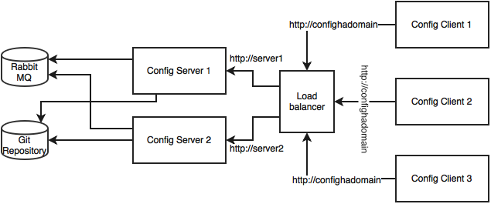
To set up a config server, you generally need to install the chosen technology and configure it according to your needs.
To define the location of the configuration store, set up security measures if necessary, and integrate the config server with your applications or systems that require configuration management.
It's important to note that the specific steps for configuring a config server can vary depending on the chosen technology and your specific use case.
It's recommended to consult the documentation and resources provided by the respective config server technology you decide to use for detailed instructions.

Slide 45
When designing the architecture for a config server, several factors need to be considered to ensure scalability, availability, and security.
Deployment Environment: Determine the deployment environment for your config server, such as on-premises servers, cloud-based infrastructure, or containerized environments like Kubernetes. The choice of environment will influence other architectural decisions.
High Availability: To ensure high availability, consider deploying multiple instances of the config server across different nodes or regions. This helps to avoid a single point of failure. Load balancers or service mesh technologies can be used to distribute traffic across these instances.
Configuration Store: Choose an appropriate storage solution to store the configuration data. This can be a version-controlled repository, a distributed key-value store, or a database. Common options include Git, Apache ZooKeeper, etcd, or a database like MySQL or PostgreSQL. The choice depends on factors like scalability requirements, consistency guarantees, and existing infrastructure.
Security: Implement appropriate security measures to protect the configuration data and ensure authorized access. This may involve securing network communication with encryption (e.g., HTTPS), implementing authentication and authorization mechanisms, and setting up access controls on the configuration store. Ensure that sensitive information like passwords or API keys are securely stored and accessed.

Slide 46
Versioning and Auditing: Consider incorporating versioning and auditing capabilities into the config server architecture. This allows you to track changes to configurations over time, roll back to previous versions if needed, and maintain an audit trail for compliance purposes.
Integration with Applications: Determine how applications will retrieve configurations from the config server. This can be done through client libraries or APIs provided by the config server technology you choose. Applications can periodically fetch configurations or subscribe to real-time notifications when changes occur.
Monitoring and Alerting: Implement monitoring and alerting mechanisms to track the health and performance of the config server. Monitor metrics like response times, error rates, and resource utilization. Set up alerts to notify administrators or operations teams in case of issues or anomalies.
Backup and Disaster Recovery: Establish backup and disaster recovery strategies for the configuration data. Regularly back up the configuration store to prevent data loss in case of failures or disasters. Consider replication or data synchronization mechanisms if you have multiple config server instances deployed.
Scalability and Load Balancing: As the number of configurations and applications increases, the config server may need to handle a higher load. Design the architecture to scale horizontally by adding more instances or using auto-scaling capabilities. Load balancing mechanisms should be in place to distribute requests evenly across the server instances.

Slide 47
Documentation and Self-Service: Provide clear documentation and self-service capabilities for developers or DevOps teams to manage and update configurations. This includes documenting the structure and format of configuration files, guidelines for managing sensitive information, and procedures for deploying changes to production.
The specifics of the architecture will depend on your specific requirements, technology choices, and the scale of your system. It's important to conduct a thorough analysis of your needs and evaluate different options to design an architecture that suits your use case.

Slide 48
Distributed Tracing System
A distributed tracing system is a tool or framework used to monitor and analyze the behavior and performance of distributed systems.
It helps trace the flow of requests as they propagate through multiple components or microservices, providing insights into the latency, dependencies, and bottlenecks within the system.
Here's an overview of the architecture and key components typically found in a distributed tracing system:
Instrumentation Libraries: Instrumentation libraries are used to add tracing code to the applications or services in your distributed system. These libraries automatically collect data about requests, including the time taken at different stages, unique identifiers, and contextual information. Common libraries include OpenTelemetry, Zipkin, Jaeger, and AppDynamics.
Trace Context Propagation: Distributed tracing relies on propagating trace context across different services. When a request enters a service, the trace context is extracted from the incoming request and added to the outgoing requests. This enables the tracing system to correlate the requests across different services and create a complete trace. Propagation can be done via headers, annotations, or other mechanisms depending on the tracing system being used.

Slide 49
Trace Collectors: Trace collectors receive and store the trace data from the instrumented services. They are responsible for aggregating and persisting the traces for analysis. Collectors can be deployed as standalone services or integrated with other monitoring or logging systems.
Trace Storage: Trace storage is where the collected trace data is stored. The traces are typically stored in a distributed database or storage system optimized for querying and analyzing large volumes of trace data. Examples of storage solutions include Elasticsearch, Cassandra, or specialized databases like Apache HBase.
Trace Analysis and Visualization: The trace data stored in the distributed tracing system can be queried and visualized to gain insights into system behavior and performance. Analysis tools allow you to search, filter, and aggregate traces based on different criteria like latency, errors, or specific services. Visualization tools provide graphical representations of trace flows, allowing you to identify bottlenecks, latency spikes, and dependencies. Popular tools in this space include Jaeger, Zipkin, and Kibana.
Alerting and Monitoring: Distributed tracing systems often offer alerting capabilities to notify administrators or operators about performance anomalies or errors. These alerts can be based on predefined thresholds or patterns detected in the trace data. Additionally, metrics and monitoring integrations may be available to track system-level performance indicators.

Slide 50
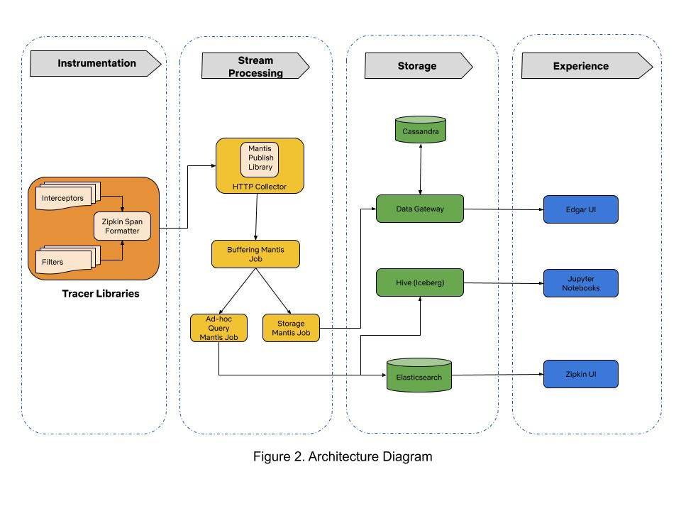
Integration with Observability Stack: A distributed tracing system is typically part of an overall observability stack, along with logging and metrics monitoring. Integration with logging frameworks like Elasticsearch, Splunk, or Logstash allows you to correlate logs and traces for deeper troubleshooting. Integration with metrics systems like Prometheus or Grafana can provide a comprehensive view of the system's health and performance.

Slide 51
It's worth mentioning that there are several open-source and commercial distributed tracing systems available, including Jaeger, Zipkin, OpenTelemetry, and Datadog's Distributed Tracing. These systems provide various components and integrations that simplify the implementation and usage of distributed tracing in your architecture.
Implementing a distributed tracing system requires careful consideration of your system's architecture, the choice of instrumentation libraries, and the integration with existing monitoring and observability tools. It's recommended to consult the documentation and resources provided by the chosen distributed tracing system to understand the specific steps and best practices for implementation.

